Slide 1
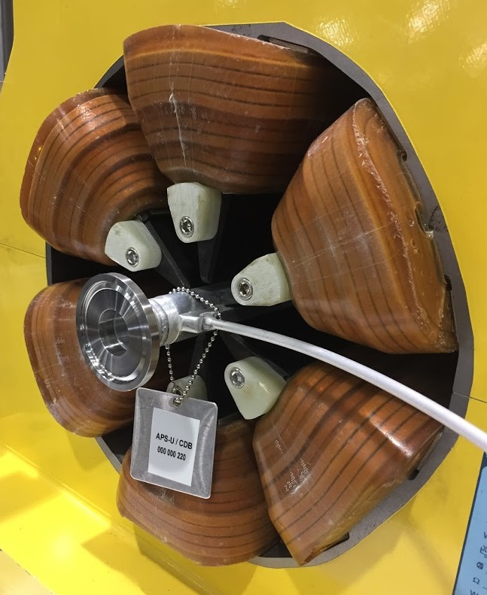
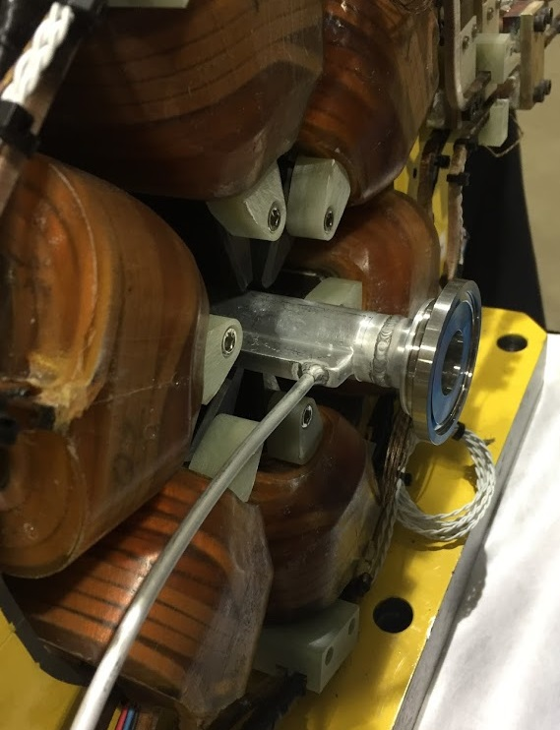

3D Numerical Ray Tracing for the APS-Upgrade Storage Ring Vacuum System Design
Jason Carter
Technical Lead, APS-U Storage Ring Vacuum System Design Group
Advanced Photon Source
Argonne National Laboratory, Lemont, IL
MEDSI 2018 Paris, France
June 28, 2018
Notes:
Univ of Chicago Review, Aug. 30, 2010
1

Slide 2
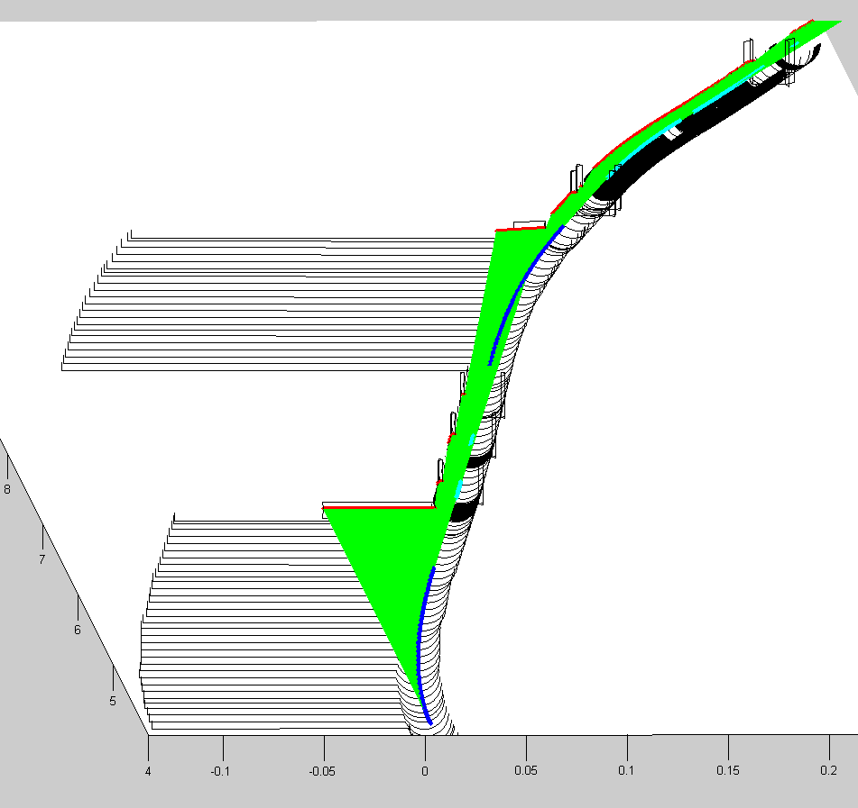
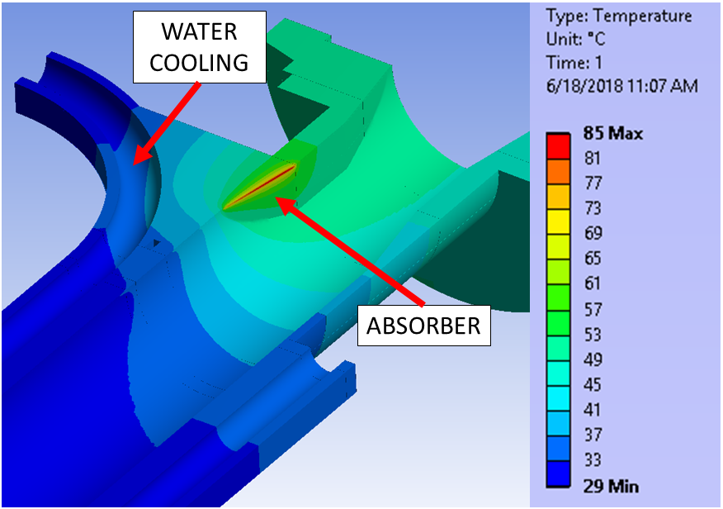
Agenda
APS Upgrade project
Project and storage ring vacuum system overview
2D ray tracing
Summary for APS-U
Limits of analysis
3D ray tracing
Motivations
New MatLab program for APS-U: Algorithm, theory, model geometry
Ray tracing results: thermal loads for ANSYS & informing beam position limits
BEAM
DIRECTION

Slide 3
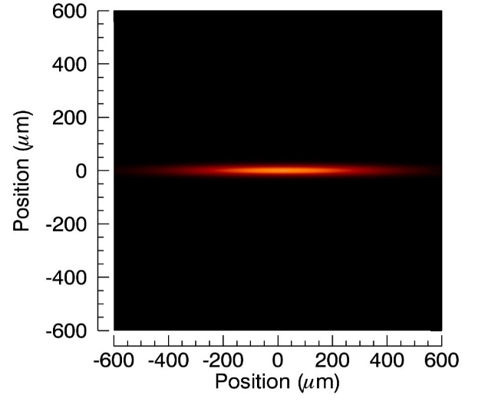
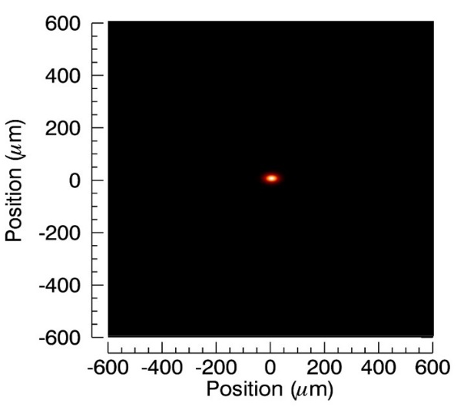
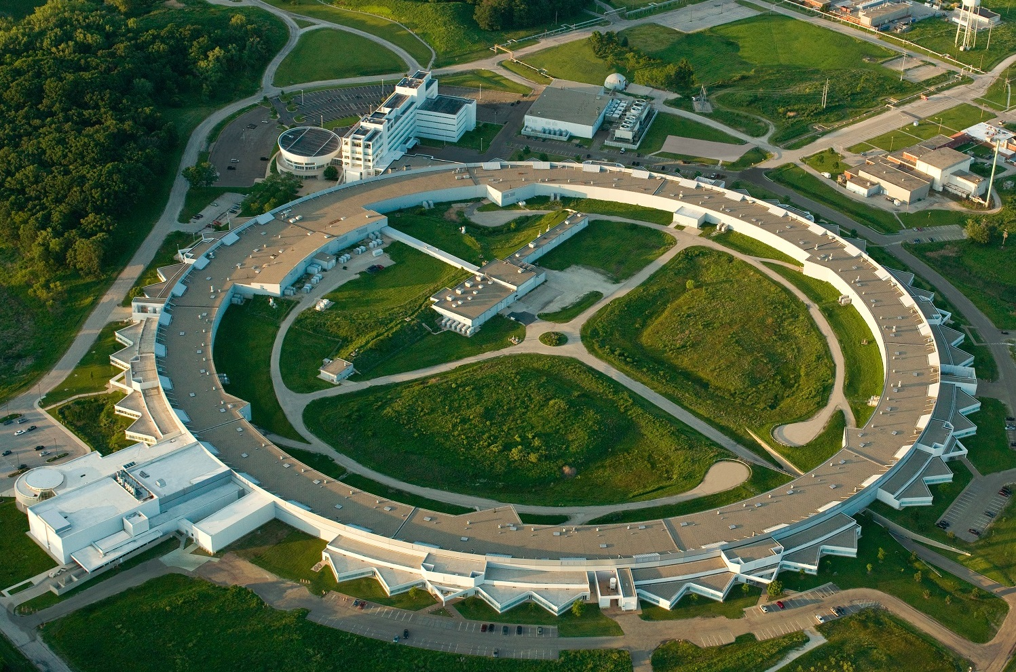
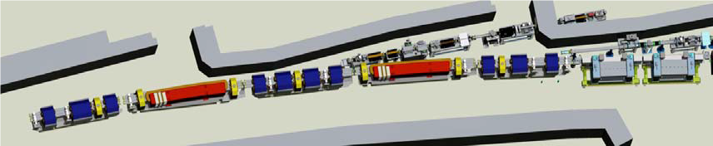
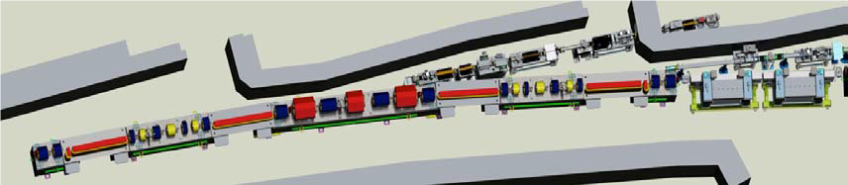
APS Upgrade Project - Overview
Advanced Photon Source (APS)
7 GeV, 100 mA, 1.1 km circumference synchrotron light source built in 1995
APS-U multi-bend achromat lattice
6 GeV, 200 mA beam current
Optimized for brightness above 4 keV
APS-U exceeds the capabilities of today’s storage rings by 2 to 3 orders of magnitude in brightness, coherent flux, and nano-focused flux
5000 hrs / year of beam to users at 95% availability
Anticipated operations ~2025
Powers entire beamline suit to meet needs of APS’s >5000 users per year
1 year APS down time (6-7 months installation)
APS
APS-U
APS today: double-bend lattice
APS-U: multi-bend lattice

Slide 4
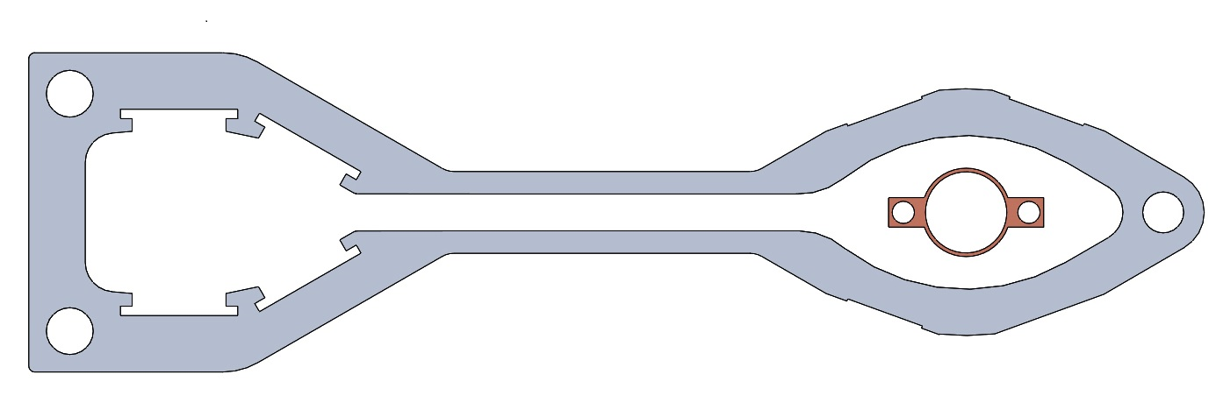
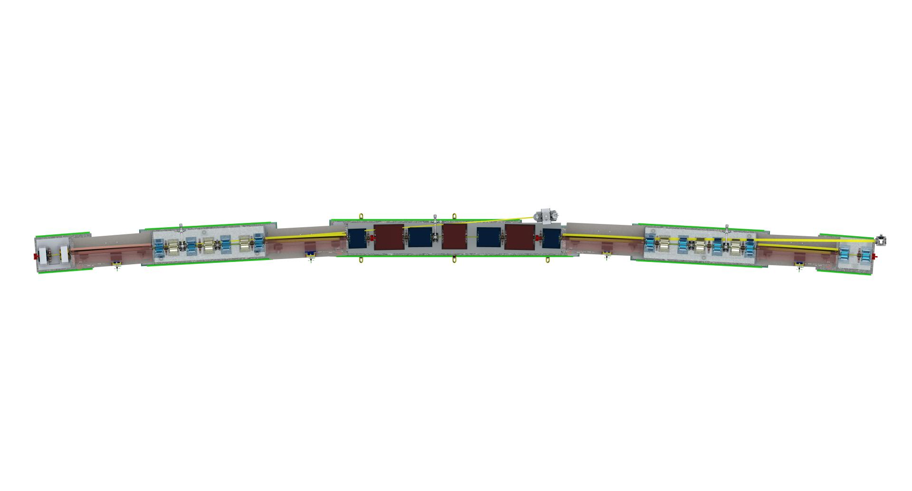
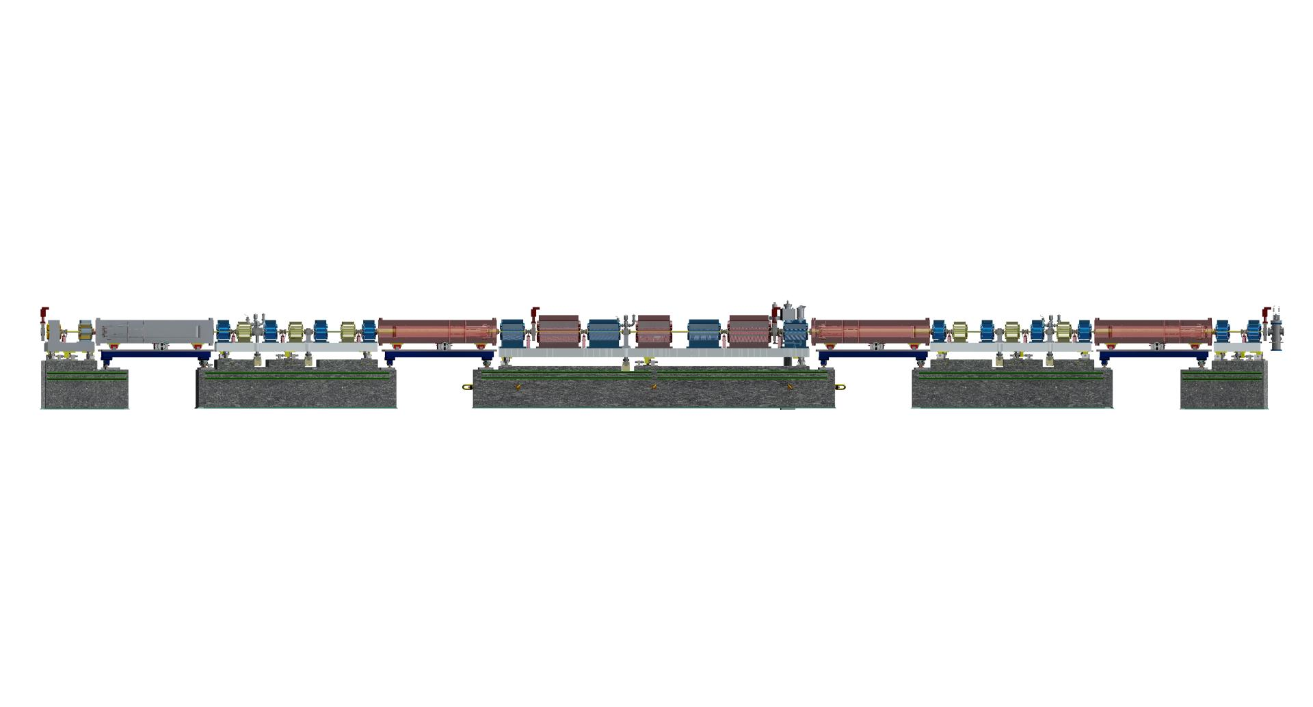
APS U Storage Ring Vacuum System - Overview
40x sectors, each ~27.6 meters in length
22 m arc sections (our scope) + 5.6 m straight sections
Small aperture vacuum chambers between narrow magnet gaps
Hybrid vacuum system design
Discrete pumping with ion pumps and lumped NEGs
Distributed pumping with NEG strips and NEG coatings
Low pressure design target for good beam lifetimes
2 nTorr @ 200 mA by 1000 A*hrs conditioning (1E-11 Torr/mA)
Existing APS storage ring chamber compared to new 22 mm ID APS-U style chamber
Beam Direction
QUAD
DOUBLET
STRAIGHT
MULTIPLET
FODO SECTION
STRAIGHT
MULTIPLET
QUAD
DOUBLET
L-BEND
L-BEND
L-BEND
L-BEND

Slide 5
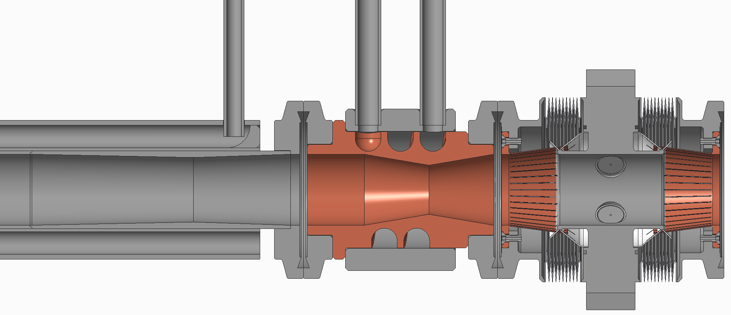
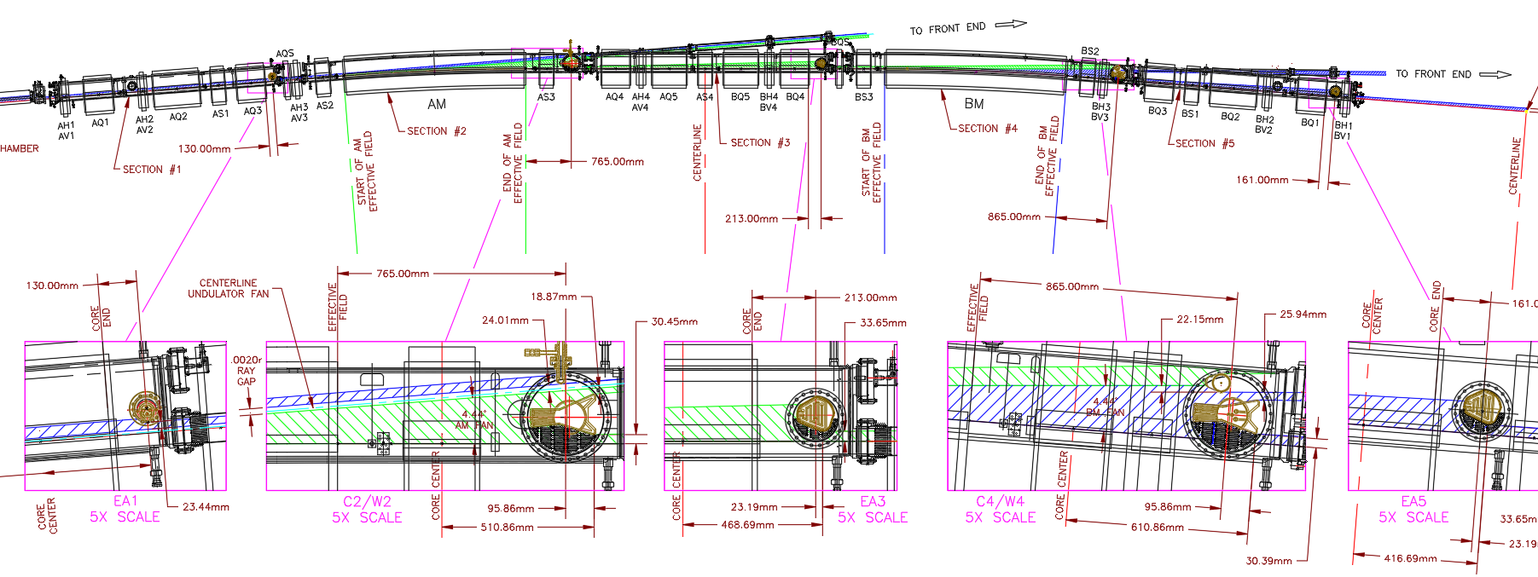
Top view ray tracing w/ 2D CAD
Conventional 2D ray tracing with a top view layout in AutoCAD
For APS, 6x discrete photon absorbers take majority of unused photon heat load
Smaller scale apertures of next-gen machines make more components participate in ray trace
For APS-U, 20x components including vacuum chambers participate in ray trace
BEAM
DIRECTION
Typical APS-U storage ring vacuum sequence: 22 mm ID chamber protecting downstream flange joint, inline absorber protecting length of downstream BPM
Original APS storage ring vacuum system 2D ray trace using AutoCAD

Slide 6
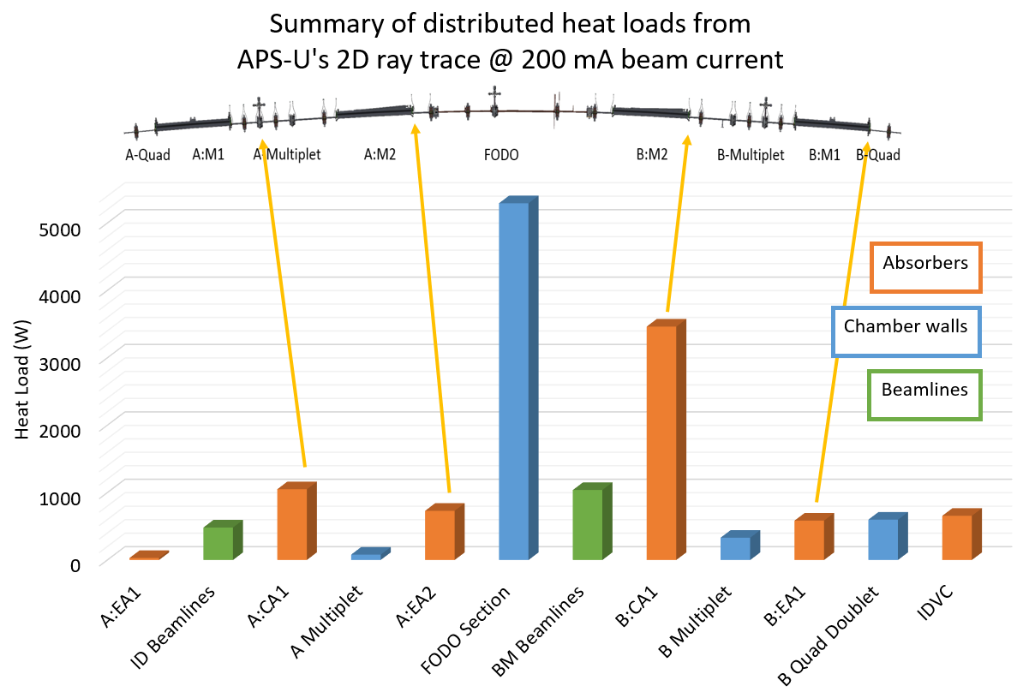
Summary of APS-U storage ring ray tracing
2D Ray Tracing for APS-U
Rays strike 20 separate vacuum components per sector and breakdown requires a complex 2D CAD layout
14.3 kW generated per sector @ 200 mA
5.3 kW on FODO section chambers
3.5 kW on B-side crotch absorber
600 W in B Quad Doublet
Ray tracing compared and verified using 3 separate tools:
2D CAD layout
SynRad, CERN’s 3D ray tracing code
New 3D MatLab program for studying beam missteering
Summary of APS-U’s 2D ray trace
Beam Direction

Slide 7
Motivations for 3D ray tracing
Difficult to ensure protection of new machines with small apertures, sensitive components, and more photon intercepting chambers and absorbers
Beam missteering happens in 3D and presents too large of a set of possibilities to capture in 2D
Absorbers and chambers need to be designed and analyzed to withstand worst-case radiation loads
How to reasonably specify limits for beam position limit detection systems?
BEAM
DIRECTION
Typical APS-U vacuum sequence: Chamber protecting downstream flange joint, inline absorber protecting length of downstream BPM
Beam Direction

Slide 8
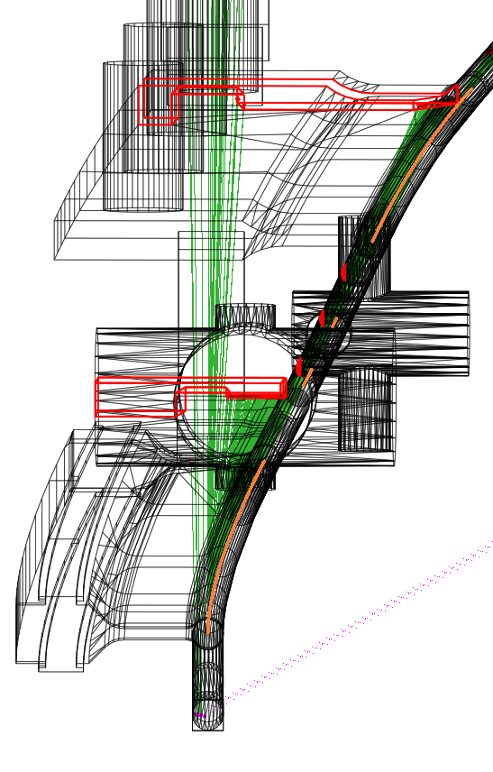
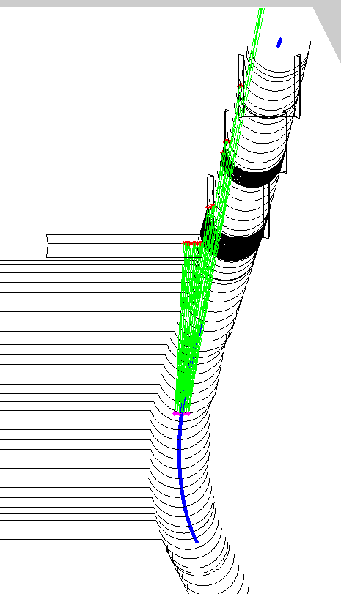
APS-U 3D ray tracing
BEAM
DIRECTION
BEAM
DIRECTION
Ray tracing compared with 3x separate tools:
2D layout: takes time to create CAD layout and break down results, modify for scenario studies
SynRad (CERN code): 3D models extracted from full vacuum system CAD assembly, quick to modify with practice, difficult to compare results across vacuum system
Numerical 3D ray tracing with new MatLab code: explore beam
Better understanding of ray tracing and missteering helps ensure robust shielding within narrow apertures
MatLab ray tracing
A:M2
L-BEND
MatLab with beam missteering
A-MULTIPLET
A:M1
L-BEND
SynRad ray tracing (absorbers highlighted in red)
Beam Direction

Slide 9
Overview of numerical ray tracing algorithm
Build geometry based on sequentially ordered geometric elements along beam path
Generate tangential rays from points along bend path
If no missteering: just one ray per point
If yes missteering: at each point, generate numerous rays with deviated positions and angles based on local phase space ellipses
Find where ray strikes by checking downstream geometry sequentially
Record data from strike on element: strike coordinates, total heat (W), intensity (W/mm, W/mm2), etc.
Use logic to find ‘worst rays’ on each element after many possible strikes
BEAM
DIRECTION
2D ray tracing model in MatLab (E-beam bends in blue, photon ‘rays’ in green, strike points in red)

Slide 10
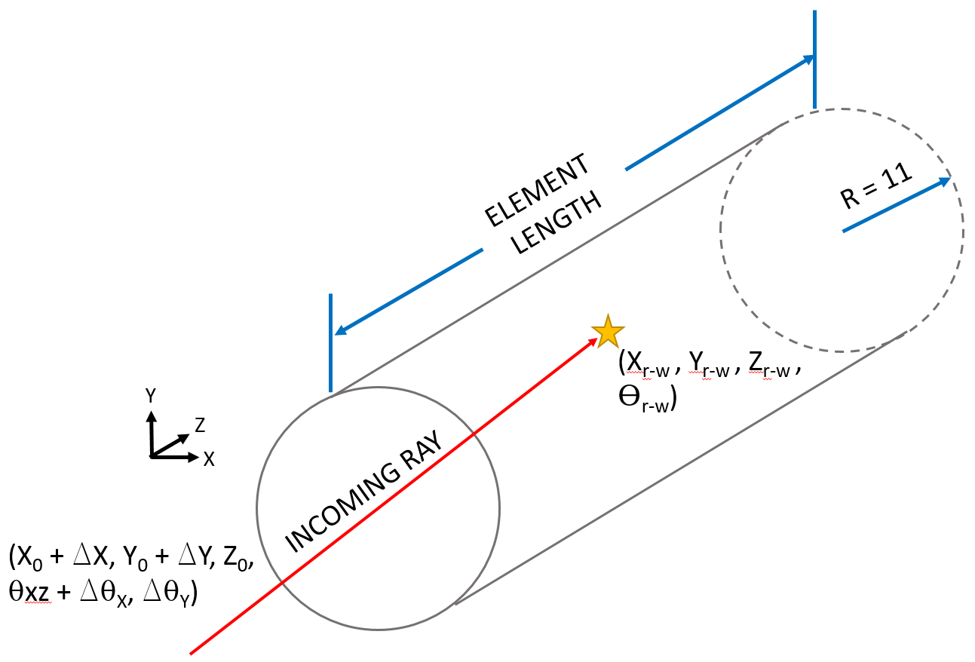
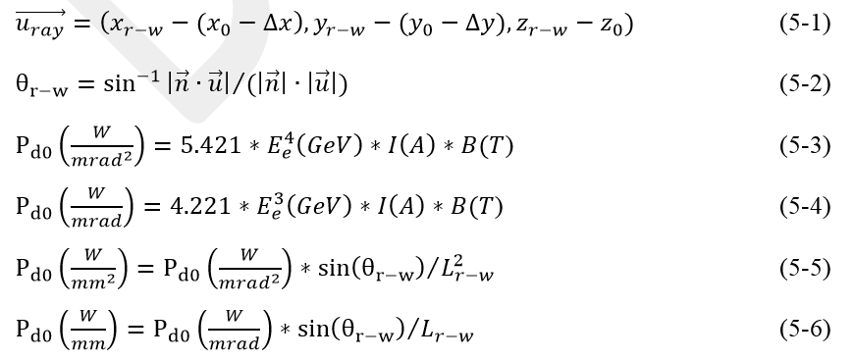
Overview of numerical ray tracing algorithm
BEAM
DIRECTION
Diagram of ray traced to intercepting geometry
2D ray tracing model in MatLab (E-beam bends in blue, photon ‘rays’ in green, strike points in red)
Common synchrotron radiation heat load equations

Slide 11
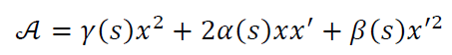
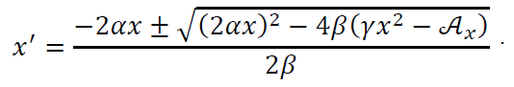
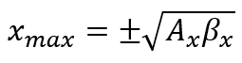
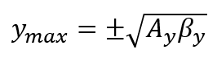
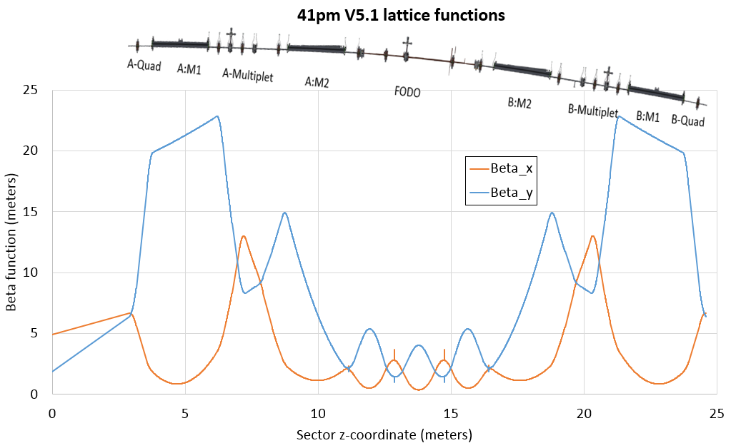
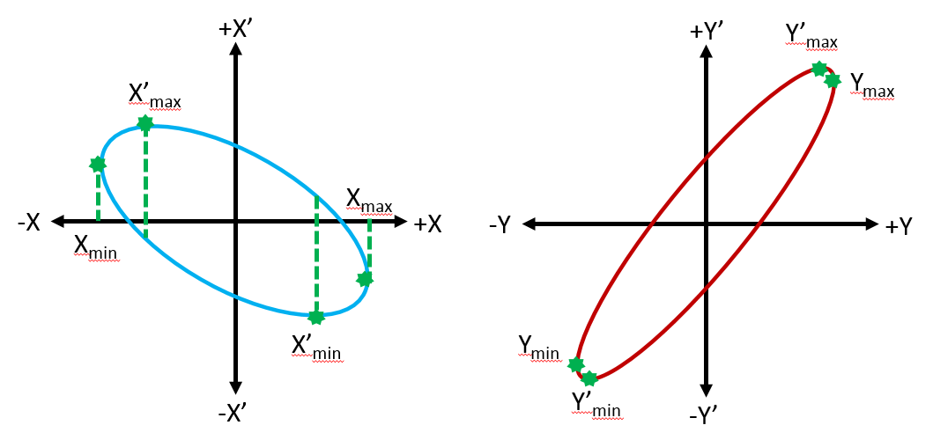
Beam orbits and lattice functions
Ellipse Equations:
Spatial and angular beam deviation possibilities from local phase space ellipses in x,y planes
Phase space ellipse extents calculated with Courant-Snyder lattice parameters
APS-U physics provides parameters along finely spaced points across the sector
Maximum beam extents limited by a limiting aperture or beam position limit detection system
Local ellipses discretized, large amounts of new ray paths with deviations tested in MatLab
Spatial extents:
Example local phase space ellipses
APS-U lattice functions in the x and y plane

Slide 12
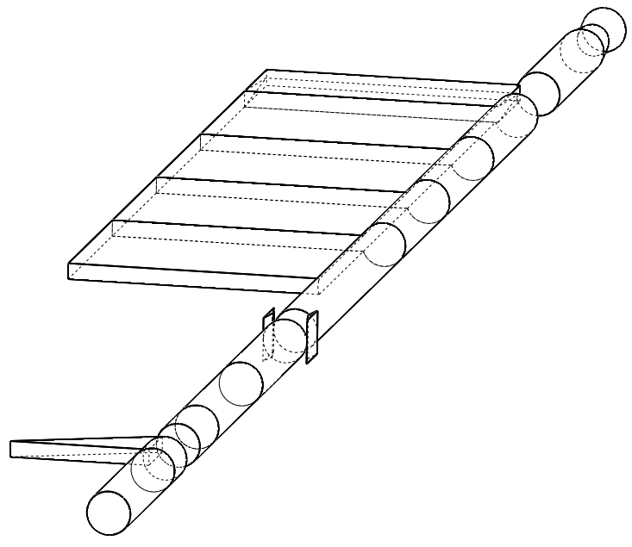
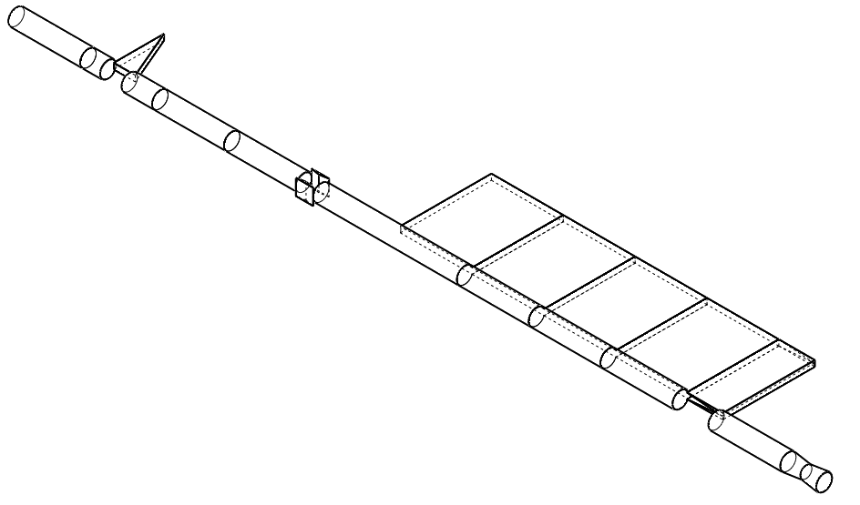
3D numerical ray tracing geometry
Geometry programmed by cross section
Round tubes
Simplified extruded chambers with antechambers
Photon absorbers (planar, conical, and v-shaped)
Photon extraction geometry not yet developed (future work!)
Current program follows geometry along the main beam path
Conical inline absorber
Crotch absorber
(v-style)
Extrusion (round aperture + pumping slot)
Inline absorber
(symmetric vertical planes)
Standard round tube
(cylinder)
End absorber (vertical plane)

Slide 13
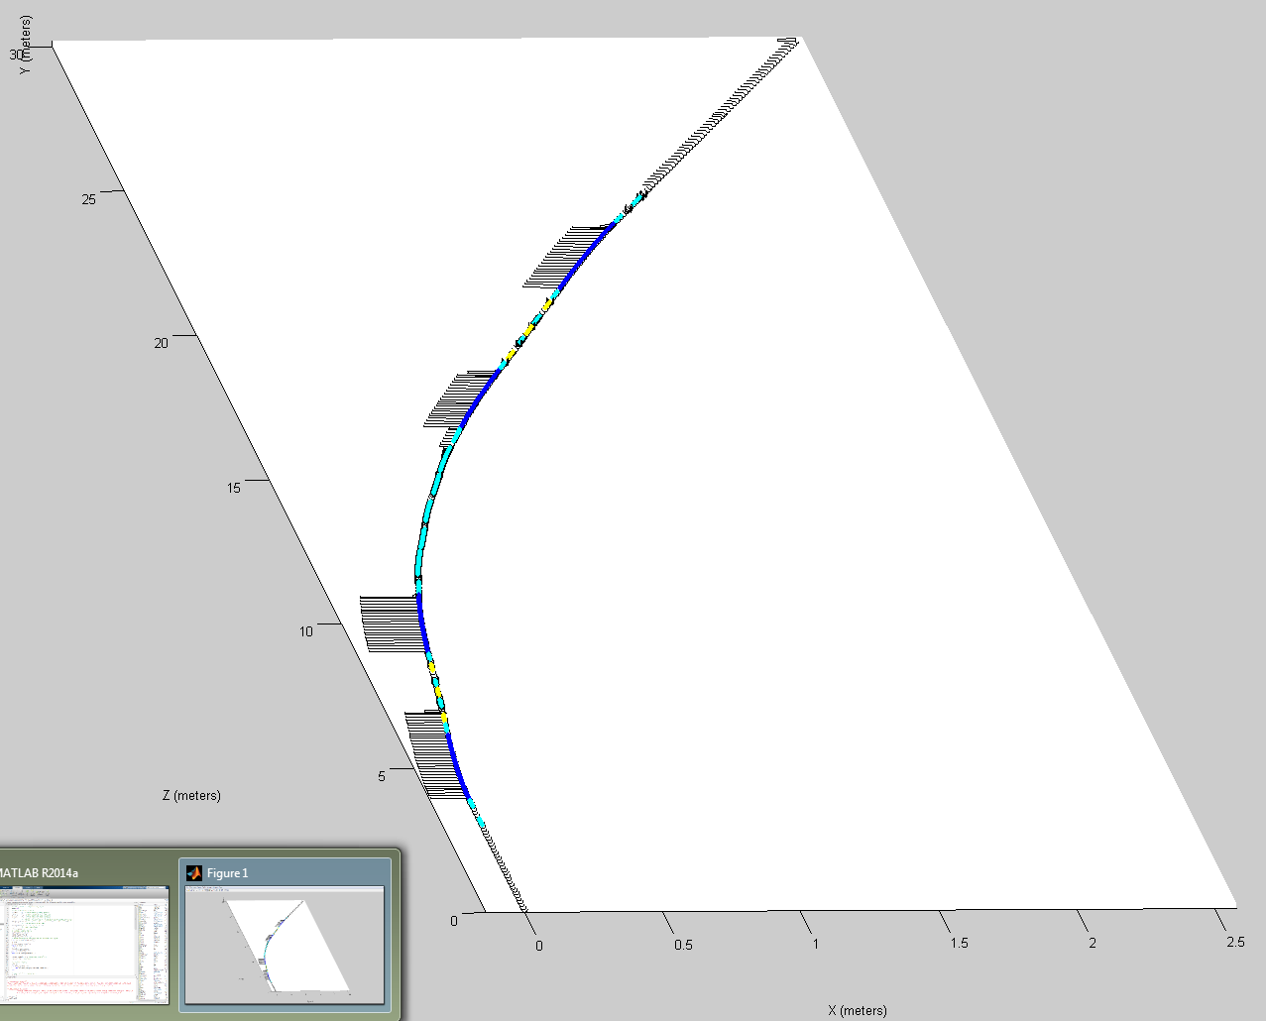
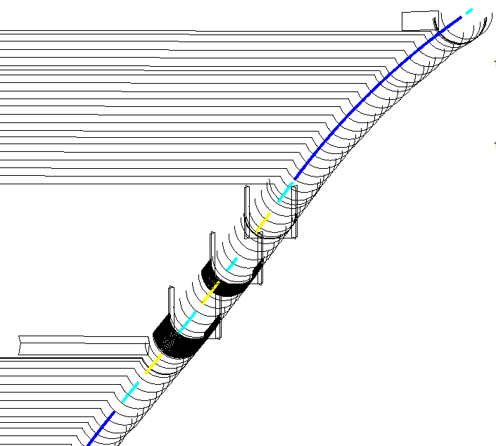
3D numerical ray tracing geometry
Full scale 27.6 m length sector APS-U model built from sequential elements
Rays generated at points along colored paths representing the magnet lattice
Dipole paths in dark blue
Quadrupoles in light blue
Sextupoles in yellow
BEAM
DIRECTION
B:M1 Magnet
B:M2 Magnet
A:M2 Magnet
A Quad Doublet Section
A:M2 Magnet
A:M1 Magnet
A:M1 Magnet

Slide 14
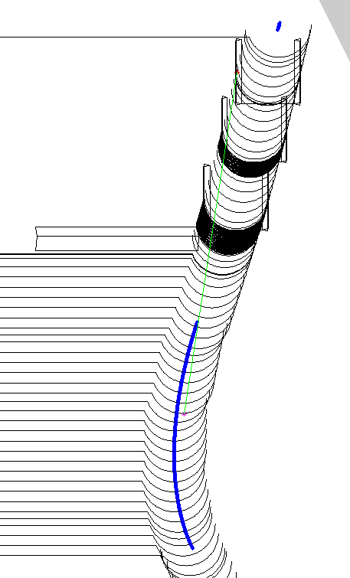
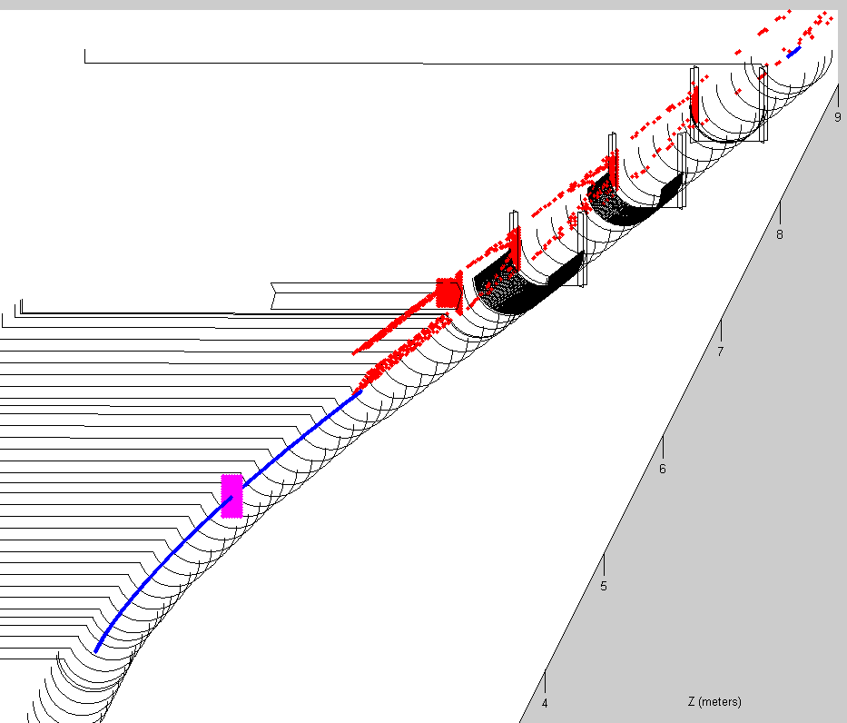
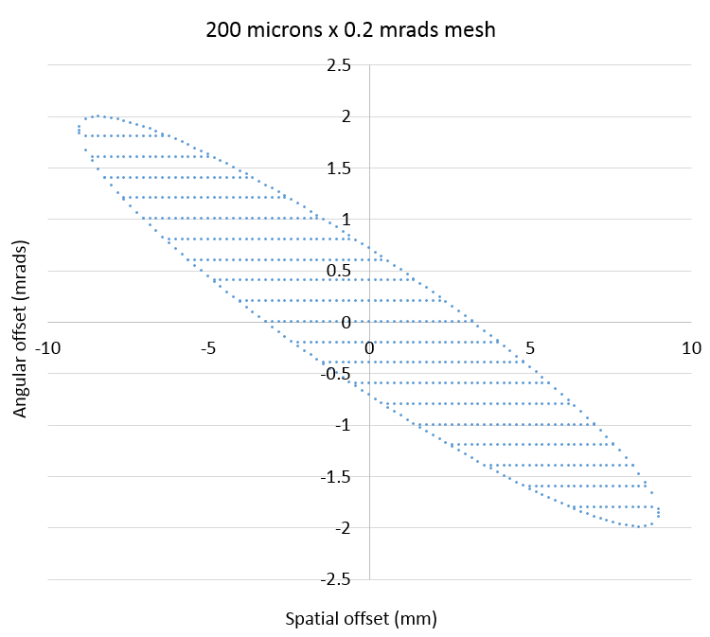
Beam missteering: X and Y planes
Full missteering from a local orbit in x-plane
Full missteering from a local orbit in both x and y-planes (green ray paths removed from image)
1 missteered ray in x-plane

Slide 15
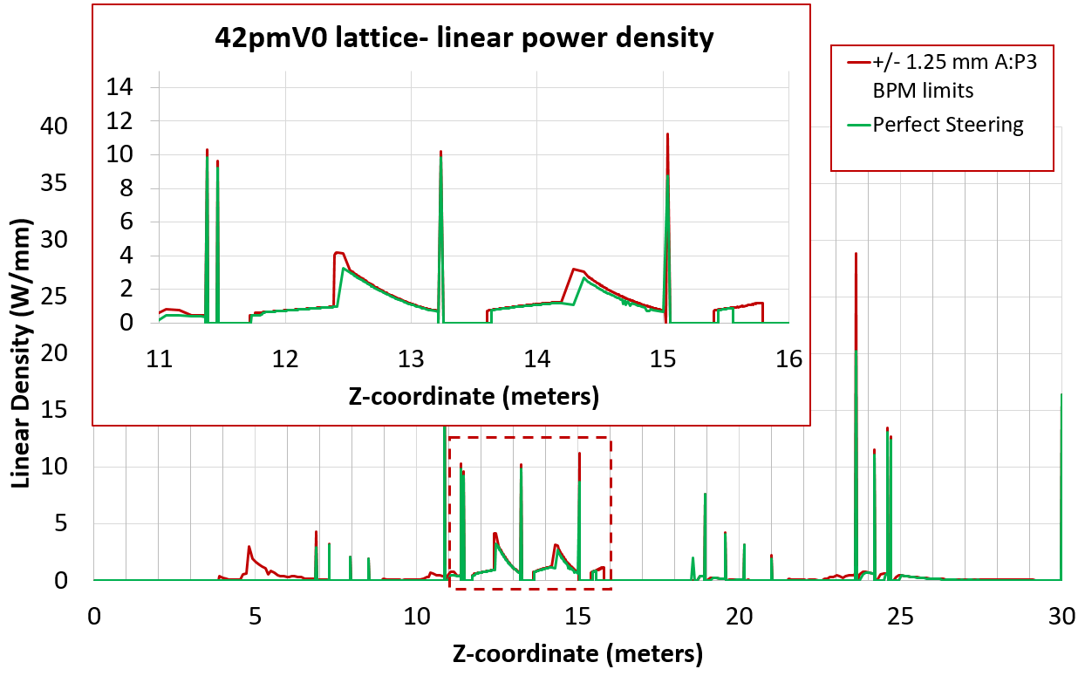
3D ray tracing results along length
Linear power across sector compared for ideal steering (green) and worst cases of missteering with a BPLD limit (red)
General nature of ray trace: spikes at compact absorber faces, high body loads on round chambers in FODO section, light body loads elsewhere
Ideal steering case has been verified to 2D ray trace and SynRad’s results

Slide 16
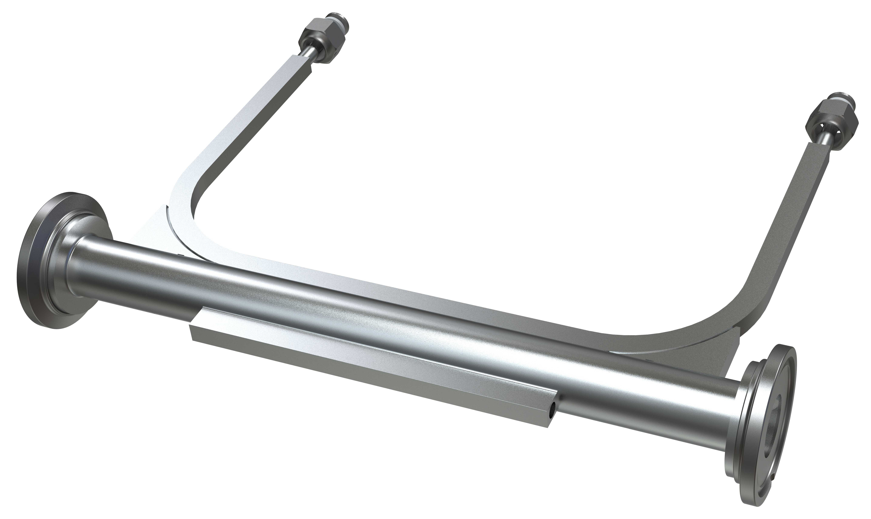
3D ray tracing results along length
Integrated results across individual chambers used for conservative boundary conditions for thermal/structural analysis
Typically ~10% higher loads than ideal case if a BPLD limit considered
Typical ANSYS thermal analysis of water-cooled APS-U chamber with inline absorber

Slide 17
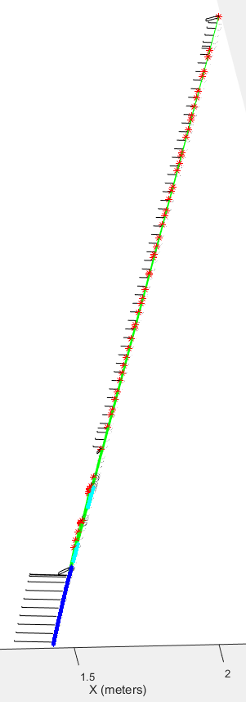
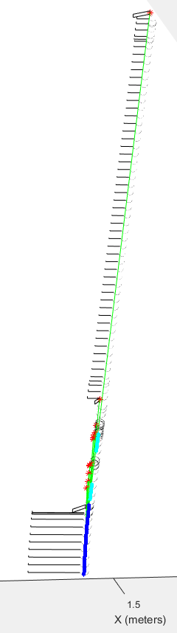
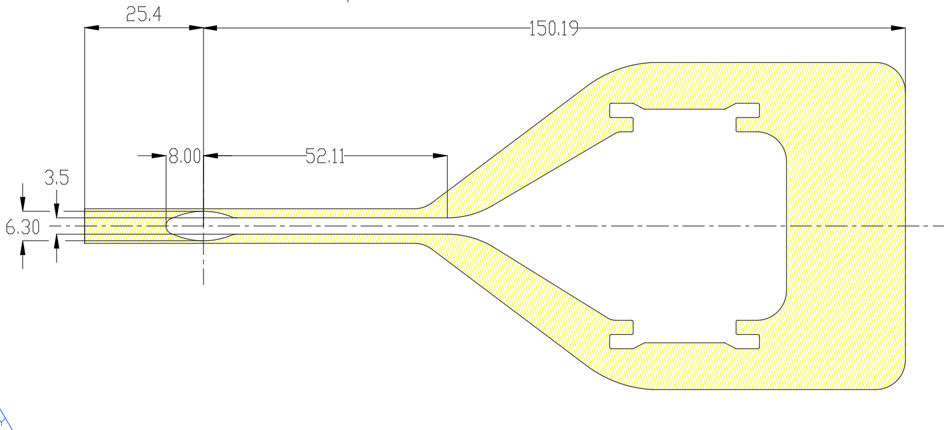
Informing BPLD limits
+/- 1.2 mm Y BPLD limit at A:P3 BPM *reaches threshold for scraping from missteered rays
+/- 1.1 mm Y BPLD limit at A:P3 BPM *all rays pass through
Straight section chambers with long, narrow, uncooled apertures
How to understand scraping possibilities and can a reasonable BPLD limit help minimize them?
Simplified model with ideal machining and alignment
Anticipate a full 200 mA BPLD limit of +/- 0.5 mm measured at a BPM (less constrained for beam current < 1 mA)
BEAM
DIRECTION
Permanent Magnet Insertion Device Vacuum Chamber:
Length: 5.322m

Slide 18
Conclusions and future work
New MatLab program to investigate ray tracing with beam missteering
Models built off of adjustable geometric parameters for system analysis and scenario studies
Post-processed graphics help investigate results in 3D
Results used for conservative heat loads in thermal analysis
Future work
Current program suited for chambers along the beam path, will develop program for extracted rays
Find efficient ways to model vacuum component misalignment
Import geometry from 3D CAD
BEAM
DIRECTION

Slide 19
Questions?

